Slide 1

Java and TDD Coding Dojo (Session 1)

Slide 2
TDD (Test-driven development)
Test-driven development (TDD) is a software development process (approach) that relies on the repetition of a very short development cycle

Slide 3
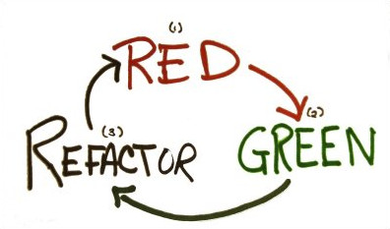
TDD Cycle
(Red) Create a unit tests that fails
(Green) Write production code that makes that test pass
(Refactor) Clean up the mess you just made

Slide 4
JAVA Basics
- JAVA The structures of a Java class and a source code file
- Executable Java applications

Slide 5
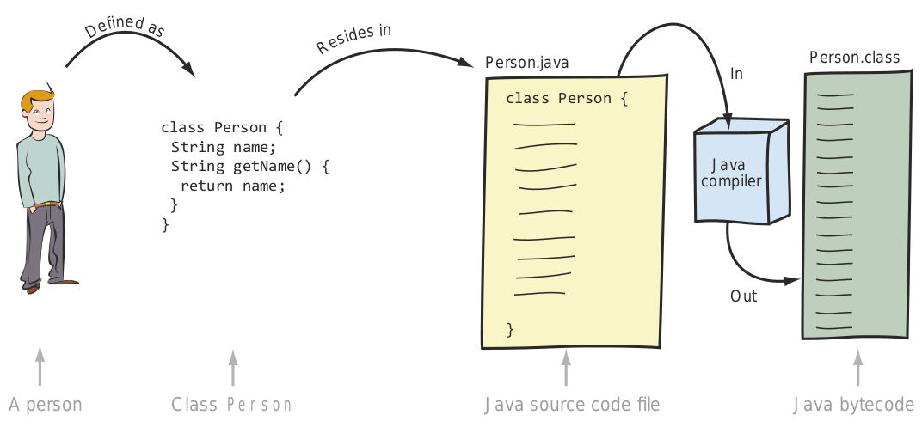
JAVA The structures of a Java class and a source code file
Relationship between the class file Person and the files Person.java and Person.class and how one transforms into another

Slide 6
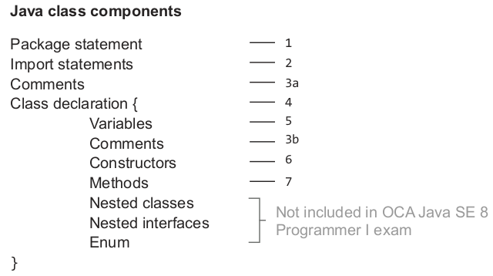
JAVA The structures of a Java class and a source code file (cont.)
Structure of a Java class

Slide 7
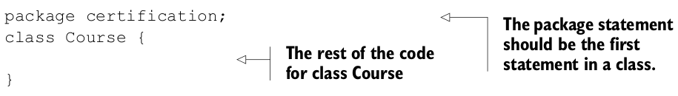
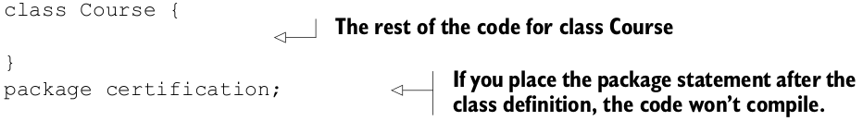
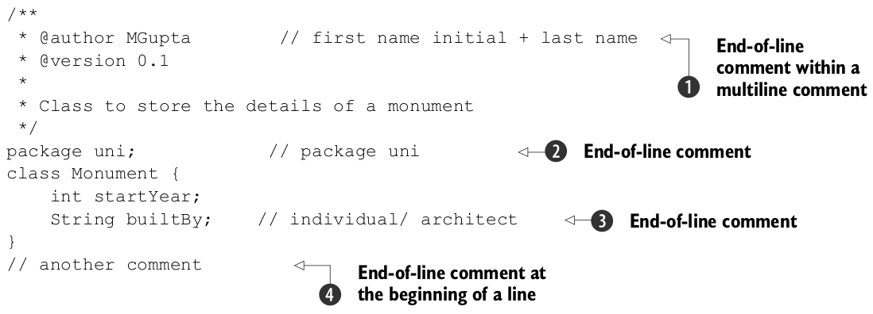
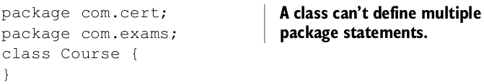
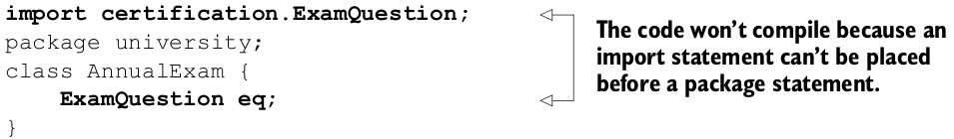
JAVA The structures of a Java class and a source code file (cont.)
PACKAGE STATEMENT
All Java classes are part of a package. The package must be define in the first line of the class, if not the code won’t compiler.

Slide 8
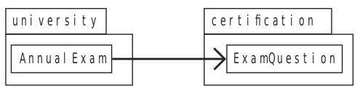
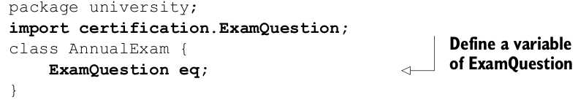
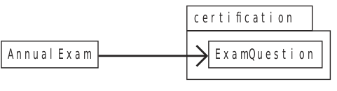
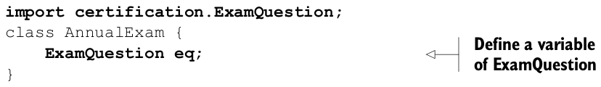
JAVA The structures of a Java class and a source code file (cont.)
IMPORT STATEMENT
Classes and interfaces in the same package can use each other without prefixing their names with the package name. But to use a class or an interface from another package, you must use its fully qualified name. Because using fully qualified names can be tedious and can make your code difficult to read, you can use the import statement to use the simple name of a class or interface in your code.
What happens if the class AnnualExam isn’t defined in a package?

Slide 9
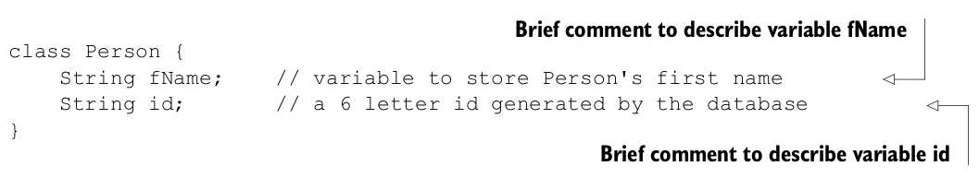
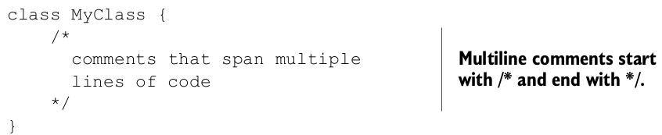
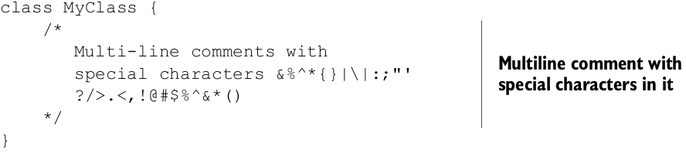

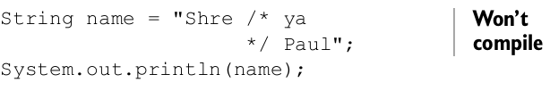
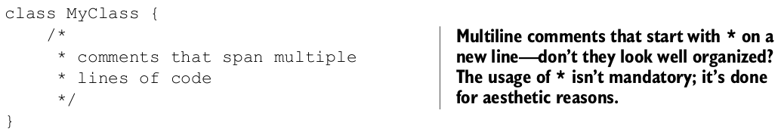
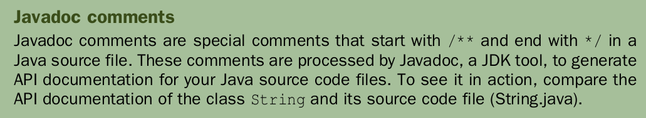
JAVA The structures of a Java class and a source code file (cont.)
COMMENTS: Comments can appear at multiple places in a class.

Slide 10
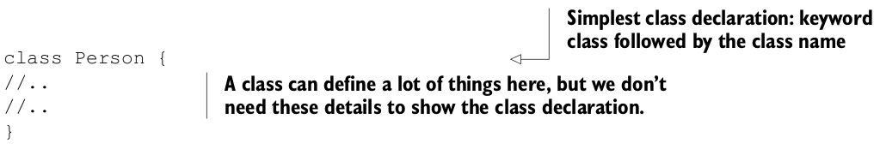
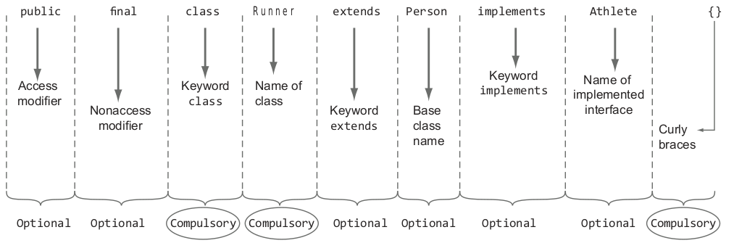
JAVA The structures of a Java class and a source code file (cont.)
CLASS DECLARATION: The class declaration marks the start of a class. It can be as simple as the keyword class followed by the name of a class.
The declaration of a class is composed of the following parts:
- Access modifiers
- Nonaccess modifiers
- Class name
- Name of the base class, if the class is extending another class
- All implemented interfaces, if the class is implementing any interfaces
- Class body (class fields, methods, constructors), included within a pair of curly braces, {}

Slide 11
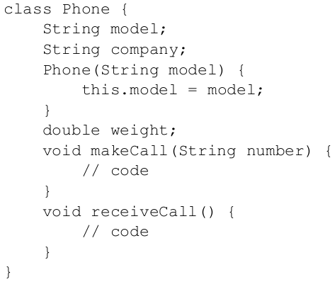
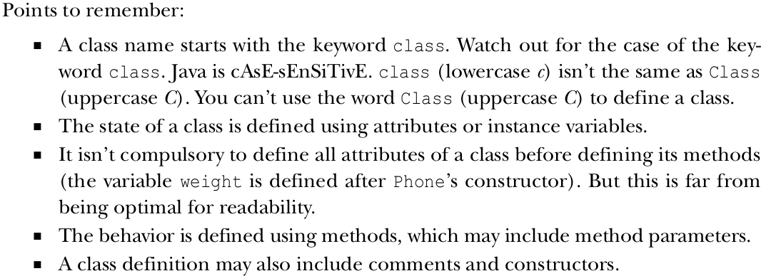
JAVA The structures of a Java class and a source code file (cont.)
CLASS DEFINITION: A class is a design used to specify the attributes and behavior of an object.

Slide 12
JAVA The structures of a Java class and a source code file (cont.)
CLASS DEFINITION: A class is a design used to specify the attributes and behavior of an object.
Variables
- Each object has its own copy of the instance variables. If you change the value of an instance variable for an object, the value for the same named instance variable won’t change for another object.
- The instance variables or instance attributes are defined within a class but outside all methods in a class.
- A single copy of a class variable or static variable is shared by all the objects of a class.
Methods
- Methods are generally used to manipulate the instance variables.
Constructors
- A class constructor is used to create and initialize the objects of a class.
- A class can define multiple constructors that accept different sets of method parameters.

Slide 13
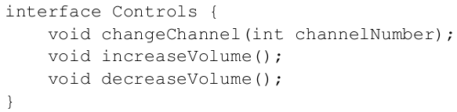
JAVA The structures of a Java class and a source code file (cont.)
DEFINITION OF AN INTERFACE IN A J AVA SOURCE CODE FILE
Interface:
- An interface specifies a contract for the classes to implement.
- You can compare implementing an interface to signing a contract.
- An interface is a grouping of related methods and constants.
- Prior to Java 8, interface methods were implicitly abstract.
- But starting with Java version 8, the methods in an interface can define a default implementation.
- With Java 8, interfaces can also define static methods.

Slide 14
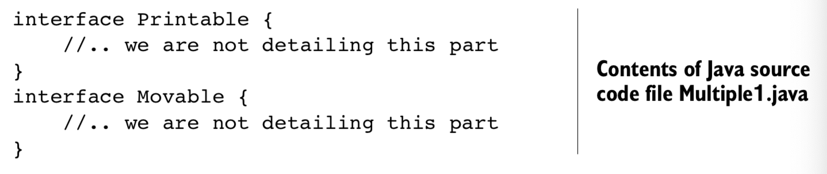
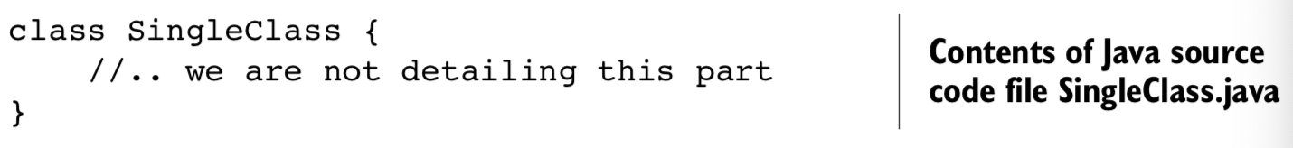
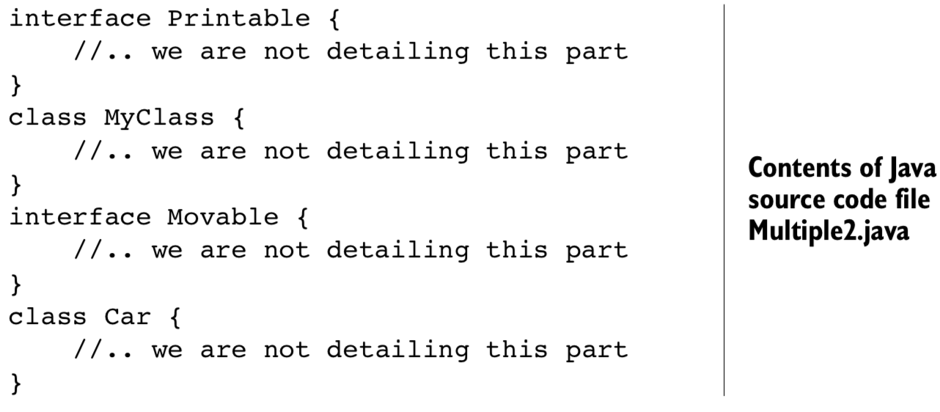
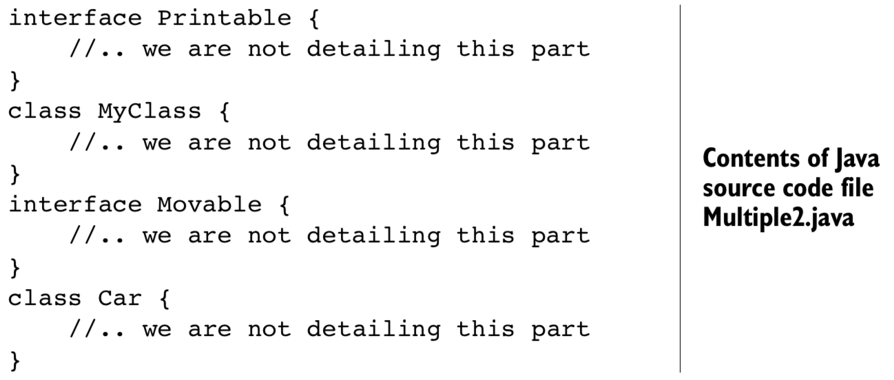
JAVA The structures of a Java class and a source code file (cont.)
DEFINITION OF SINGLE AND MULTIPLE CLASSES IN A SINGLE J AVA SOURCE CODE FILE
No particular order is required to define multiple classes or interfaces in a single Java source code file.
When you define a public class or an interface in a Java source file, the names of the class or interface and Java source file must match. Also, a source code file can’t define more than one public class or interface. If you try to do so, your code won’t compile

Slide 15
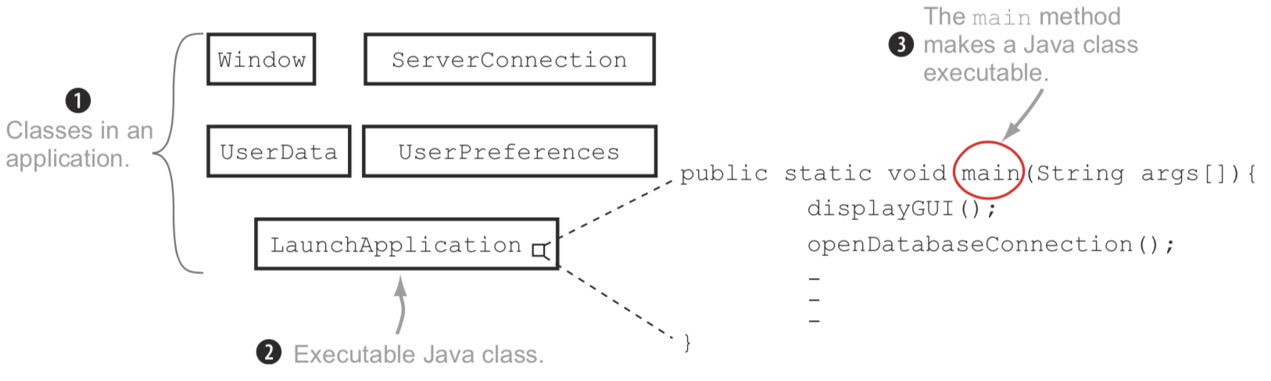
Executable Java applications
Executable Java classes versus non-executable Java classes
An executable Java class, when handed over to the JVM, starts its execution at a particular point in the class—the main method.
A Java application can define more than one executable class. We choose one (and exactly one) when the time comes to start its execution by the JVM.

Slide 16
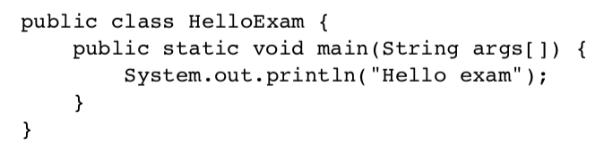
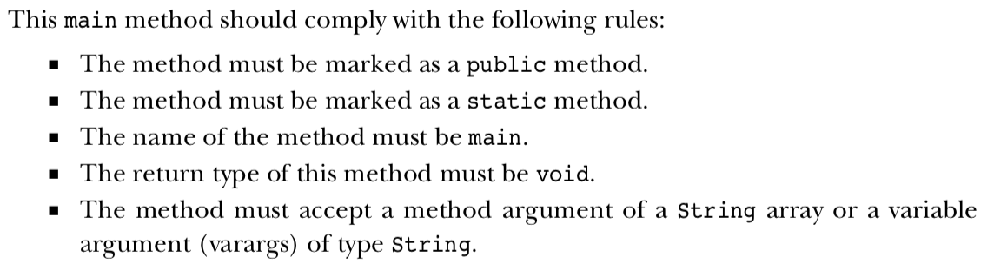
Executable Java applications (cont.)
The main method

Slide 17
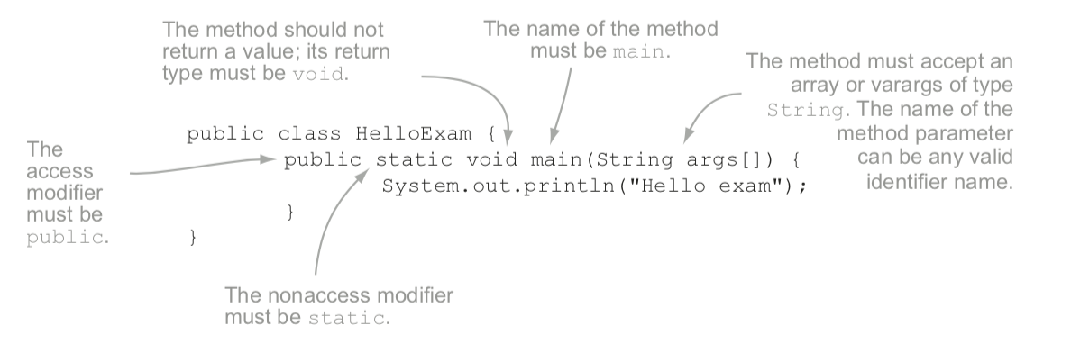
Executable Java applications (cont.)
The main method

Slide 18
Executable Java applications (cont.)
The main method

Slide 19
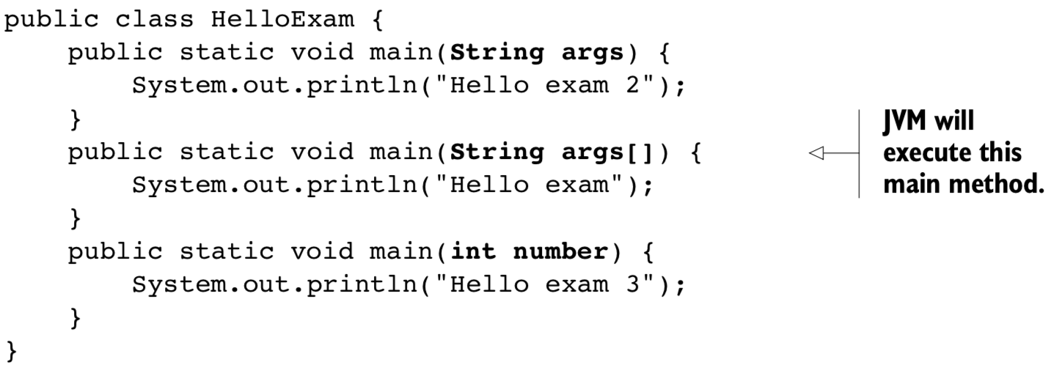
Executable Java applications (cont.)
If a class defines a main method that doesn’t match the signature of the main method, it’s referred to as an overloaded method

Slide 20
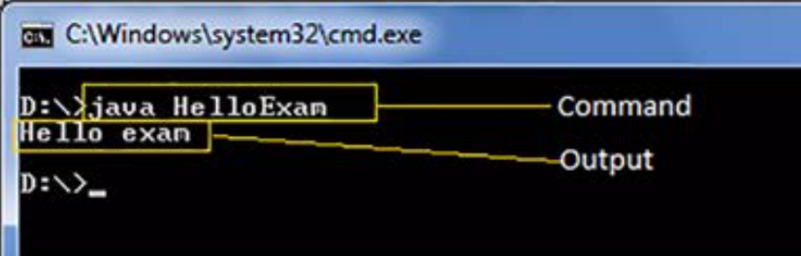
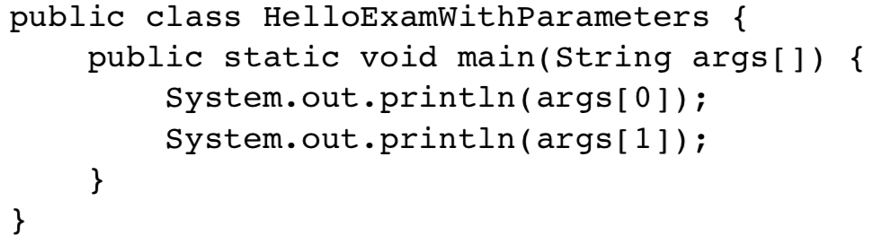
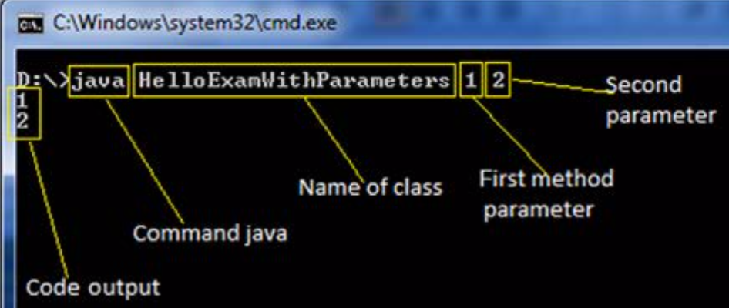
Executable Java applications (cont.)
Run a Java program from the command line

Slide 21
End session 1

